Slide 1
Kotlin
Backend Development
Notes:
Overview

Slide 2
Network Basics
- **Computer Networks**: Systems that allow computers to communicate
Internet Protocol (IP): System for identifying computers
Ports: Communication channels on a computer (0-65535)

Slide 3
Connections
- **Connection**: Communication pathway between two programs
- Like a phone call between two computers
- **Connection Information**:
- Source IP and port
- Destination IP and port
- **TCP Protocol**: Reliable, ordered delivery

Slide 4
IPv4
- An Internet Protocol address (IP address)
- **x.x.x.x (Address structure)**:
- **127.0.0.1 (Localhost)**:
- Always refers to your own computer
- Useful for testing without network access
- Also accessible as "localhost"
- **0.0.0.0**:
- Means "all available network interfaces"
- When a server listens on 0.0.0.0, it accepts connections from any network interface
- Used to make servers accessible from other computers
- **255.255.255.255**: Broadcast address (sends to all devices on local network)
- **192.168.x.x and 10.x.x.x** Private addresses (only work on local networks)

Slide 5
Sockets
- **Socket**: Programming tool for network communication
- **What Sockets Do**:
- Create network connections
- Send data over the network
- Receive data from the network
- **Socket Types in Kotlin**:
- **Socket**: For TCP connections (reliable)
- **ServerSocket**: For accepting TCP connections
- **DatagramSocket**: For UDP communication (simpler, faster)

Slide 6
Client-Server Model
- **Server**: Program that waits for connections and provides a service
- Listens on a specific port
- Handles multiple client connections
- Example: Web server, game server, chat server
- **Client**: Program that connects to a server to use its service
- Initiates the connection to the server
- Often has a user interface
- Example: Web browser, game client, chat app
- **Communication**: Two-way exchange of data

Slide 7
Server Socket
// Create a server socket on port 8080
val serverSocket = ServerSocket(8080)
println("Server started on port 8080")
// Accept one client connection
val clientSocket = serverSocket.accept()
println("Client connected!")
// Create a writer to send data to the client
val writer = PrintWriter(clientSocket.getOutputStream(), true)
// Send a message
writer.println("Hello from Kotlin server!")
// Clean up
clientSocket.close()
serverSocket.close()
println("Server stopped")

Slide 8
Client Socket
// Connect to the server (localhost = 127.0.0.1)
val socket = Socket("localhost", 8080)
println("Connected to server")
// Set up reader to receive data
val reader = BufferedReader(InputStreamReader(socket.getInputStream()))
// Read and print the message from server
val message = reader.readLine()
println("Server says: $message")
// Clean up
socket.close()
println("Connection closed")

Slide 9
What is Backend?
- The server-side of an application that users don't directly interact with
- Handles core business logic, data storage, and security
- Communicates with other systems (databases, services, etc.)
- Serves data and functionality to frontends (web, mobile apps)
- Runs on servers or cloud platforms
- Often built as a set of services or APIs

Slide 10
Web APIs
- APIs that communicate over the internet using HTTP
- Client-server communication model
- Common formats: JSON, XML
- Technology agnostic (different languages can communicate)
- Types:
- SOAP: Uses XML, more rigid structure
- REST: Uses HTTP methods, resource-based
- GraphQL: Query language for APIs, flexible data fetching
- RPC: Remote Procedure Call, action-based

Slide 11
HTTP
- text based communication protocol (http 1.*)
- can handle text and binary data

Slide 12
Http Request
curl -v http://google.com
* Host google.com:80 was resolved.
* IPv6: (none)
* IPv4: 216.58.206.46
* Trying 216.58.206.46:80...
* Connected to google.com (216.58.206.46) port 80
> GET / HTTP/1.1
> Host: google.com
> User-Agent: curl/8.7.1
> Accept: */*
>
* Request completely sent off

Slide 13
Http Response
< HTTP/1.1 301 Moved Permanently
< Location: http://www.google.com/
< Content-Type: text/html; charset=UTF-8
< Content-Security-Policy-Report-Only: object-src 'none';base-uri 'self';script-src 'nonce-z-LCHgth0elAZCmPgxyuFA' 'strict-dynamic' 'report-sample' 'unsafe-eval' 'unsafe-inline' https: http:;report-uri https://csp.withgoogle.com/csp/gws/other-hp
< Date: Mon, 05 May 2025 10:57:07 GMT
< Expires: Wed, 04 Jun 2025 10:57:07 GMT
< Cache-Control: public, max-age=2592000
< Server: gws
< Content-Length: 219
< X-XSS-Protection: 0
< X-Frame-Options: SAMEORIGIN

Slide 14
Http Response
<
<HTML><HEAD><meta http-equiv="content-type" content="text/html;charset=utf-8">
<TITLE>301 Moved</TITLE></HEAD><BODY>
<H1>301 Moved</H1>
The document has moved
<A HREF="http://www.google.com/">here</A>.
</BODY></HTML>
* Connection #0 to host google.com left intact

Slide 15
REST
- REST = Representational State Transfer
- Architectural style for web APIs created by Roy Fielding (2000)
- Based on key principles:
- Uses HTTP methods (GET, POST, PUT, DELETE)
- Resource-based (URLs represent resources)
- Stateless (server doesn't store client state)
- Uniform interface (consistent interaction patterns)
- Client-server separation (independent evolution)

Slide 16
Http Methods in REST
- **GET**: Retrieve data (read-only, safe)
- Example: `GET /users/123` - Get user with ID 123
- **POST**: Create new resources
- Example: `POST /users` - Create a new user
- **PUT**: Update existing resources (full replacement)
- Example: `PUT /users/123` - Update entire user 123
- **PATCH**: Partially update resources
- Example: `PATCH /users/123` - Update parts of user 123
- **DELETE**: Remove resources
- Example: `DELETE /users/123` - Delete user 123

Slide 17
REST Resources and URLs
- Resources are the key objects in your system
- Example: users, products, tasks
- URLs (endpoints) identify resources
- Collection: `/users` (all users)
- Individual: `/users/123` (specific user)
- Hierarchical relationships
- `/users/123/orders` (orders for user 123)
- Query parameters for filtering, sorting, pagination
- `/products?category=electronics&sort=price`

Slide 18
HTTP Status Codes
- Numeric codes that indicate request outcome
- Grouped by first digit:
- **2xx**: Success
- 200 OK, 201 Created, 204 No Content
- **3xx**: Redirection
- 301 Moved Permanently, 304 Not Modified
- **4xx**: Client Error
- 400 Bad Request, 401 Unauthorized, 404 Not Found
- **5xx**: Server Error
- 500 Internal Server Error, 503 Service Unavailable
- Helps clients understand what happened

Slide 19
REST API Benefits
- **Scalability**: Stateless nature helps scaling
- **Flexibility**: Clients can evolve independently
- **Portability**: Works across platforms and languages
- **Visibility**: Clear HTTP interactions
- **Reliability**: Well-understood caching and error handling
- **Simplicity**: Easier to understand and implement
- **Widespread adoption**: Industry standard

Slide 20
Backend Framework Basics
- Frameworks provide structure and common functionality
- Handle repetitive tasks (routing, serialization, etc.)
- Common features:
- HTTP server functionality
- Routing system
- Request/response handling
- Data validation
- Database integration
- Authentication/Authorization
- Testing support
- Logging and monitoring

Slide 21
Introduction to Ktor
- Close to HTTP
- Lightweight, asynchronous web framework for Kotlin
- Developed by JetBrains
- Ideal for microservices, HTTP APIs, and RESTful applications
- Current version: 3.1.2 (March 2025)
- Highly modular with plugin-based architecture

Slide 22
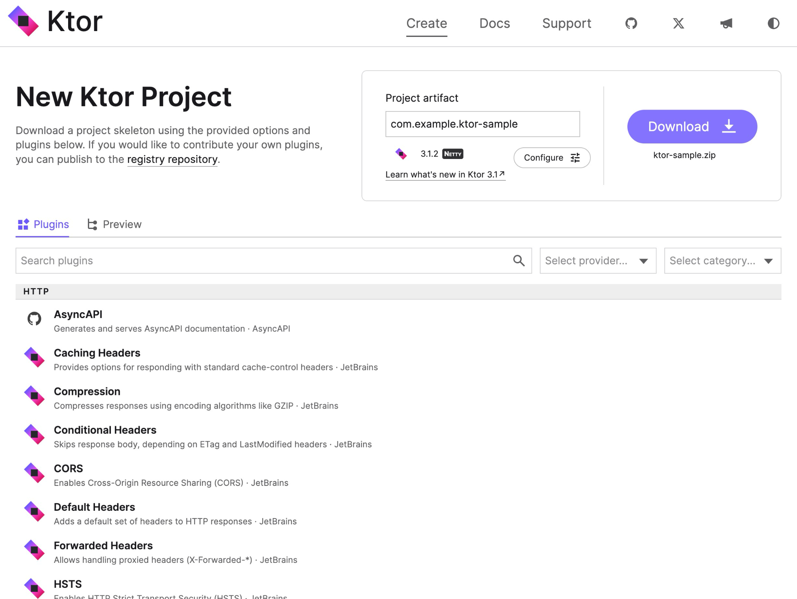
Setting Up a Ktor Project
- Use the Ktor Project Generator at https://start.ktor.io
- Select your preferences:
- Build system (Gradle with Kotlin DSL recommended)
- Ktor version
- Server engine (Netty, CIO, Tomcat, etc.)
- Required plugins

Slide 23
Starting Ktor application
fun main() {
// Start Ktor server with Netty engine
embeddedServer(
Netty, // Engine
port = 8080, // Port
host = "0.0.0.0",// Host
module = Application::module // Module function
).start(wait = true)
}

Slide 24
Simple Ktor Application
fun Application.module() {
routing {
get("/") {
call.respondText("Hello World!")
}
}
}

Slide 25
Building Routes
fun Application.configureRouting() {
routing {
// Define a GET endpoint
get("/") {
call.respondText("Hello, Ktor!")
}
// Define a GET endpoint with JSON response
get("/info") {
call.respond(mapOf("version" to "1.0"))
}
}
}

Slide 26
Building Routes
route("/api") {
// Nested routes
route("/v1") {
// Tasks API endpoints
route("/tasks") {
get { /* Get all tasks */ }
post { /* Create a task */ }
// Path parameters
route("/{id}") {
get { /* Get task by ID */ }
put { /* Update task */ }
delete { /* Delete task */ }
}
}
}
}

Slide 27
Request Parameters
// /tasks/42
get("/tasks/{id}") {
val id = call.parameters["id"]?.toIntOrNull()
if (id == null) {
call.respond(HttpStatusCode.BadRequest, "Invalid ID format")
return@get
}
// Use the ID parameter
}

Slide 28
Query Parameters
// /tasks?id=42
get("/tasks") {
val id = call.queryParameters["id"]?.toIntOrNull()
if (id == null) {
call.respond(HttpStatusCode.BadRequest, "Invalid ID format")
return@get
}
// Use the ID parameter
}

Slide 29
Plugins in Ktor
- ContentNegotiation: Handles serialization/deserialization
- Routing: Manages HTTP route definitions
- Authentication: Handles user authentication
- CORS: Manages cross-origin resource sharing
- StatusPages: Handles errors and exceptions
- Compression: Compresses HTTP responses
- CallLogging: Logs HTTP requests and responses

Slide 30
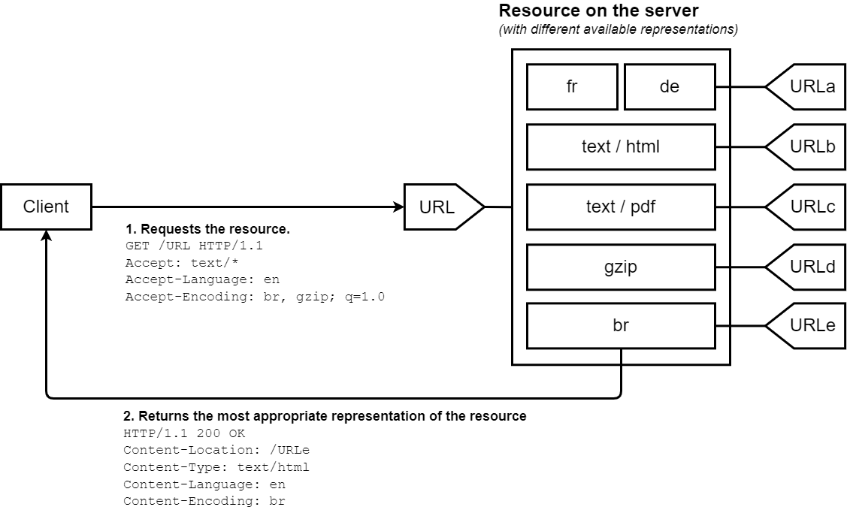
Content Negotiation
https://developer.mozilla.org/en-US/docs/Web/HTTP/Guides/Content_negotiation

Slide 31
Content Negotiation
fun Application.configureSerialization() {
install(ContentNegotiation) {
// Use kotlinx.serialization for JSON
json()
// Alternative: Use Gson
// gson()
// Alternative: Use Jackson
// jackson()
}
}

Slide 32
Content Negotiation
@Serializable
data class Task(
val id: Int? = null,
val title: String,
val description: String,
val completed: Boolean = false
)

Slide 33
Content Negotiation: send
fun Application.module() {
routing {
get("/") {
call.respond(HttpStatusCode.OK, Task(....))
}
}
}

Slide 34
Content Negotiation: receive
post("/tasks") {
try {
// Parse the request body into a Task object
val task = call.receive<Task>()
// Process the task
// ...
// Respond with the created task
call.respond(HttpStatusCode.Created, task)
} catch (e: ContentTransformationException) {
call.respond(
HttpStatusCode.BadRequest,
"Invalid task format: ${e.message}"
)
}
}

Slide 35
Error Handling
fun Application.configureStatusPages() {
install(StatusPages) {
// Handle exceptions thrown during routing
exception<Throwable> { call, cause ->
call.respond(HttpStatusCode.BadRequest, "Invalid request format")
}
...
status(HttpStatusCode.NotFound) { call, status ->
call.respond(
status,
mapOf("error" to "The requested resource was not found")
)
}

Slide 36
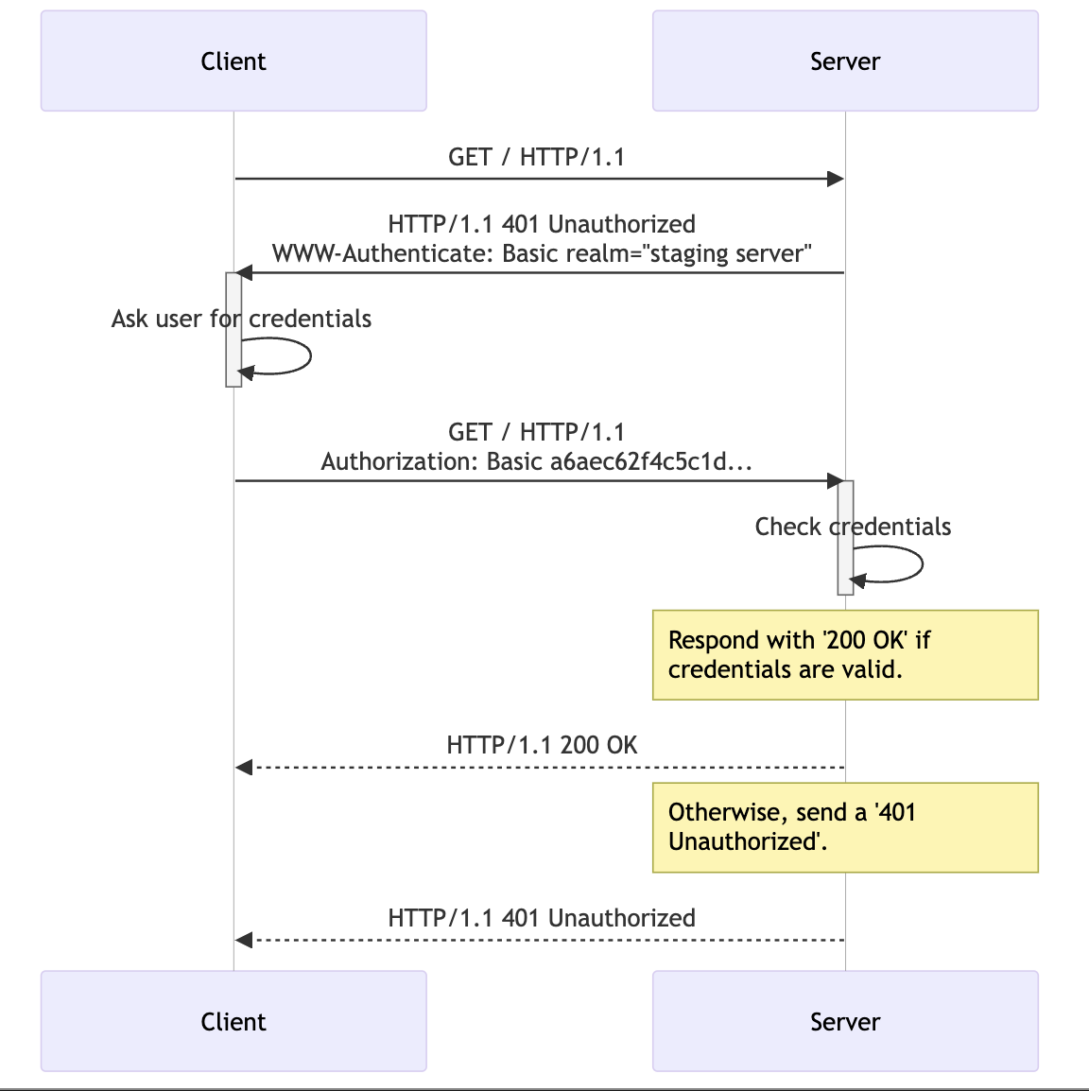
Authentication
https://developer.mozilla.org/en-US/docs/Web/HTTP/Guides/Authentication

Slide 37
Basic Authentication Config
fun Application.configureAuthentication() {
install(Authentication) {
// Basic authentication
basic("auth-basic") {
validate { credentials ->
if (credentials.name == "admin" &&
credentials.password == "password") {
UserIdPrincipal(credentials.name)
} else {
null
}
}
}
...

Slide 38
Authentication Use
routing {
// Public routes
get("/public") {
call.respondText("Public endpoint")
}
// Protected routes
authenticate("auth-basic") {
get("/protected") {
val principal = call.principal<UserIdPrincipal>()
call.respondText("Protected endpoint, user: ${principal?.name}")
}
}

Slide 39
Testing
class TaskApiTest {
@Test
fun `get all tasks returns 200`() = testApplication {
application {
configureRoutine()
}
val client = createClient {
install(ContentNegotiation) {
json()
}
}
...

Slide 40
Testing
// Perform test request
val response = client.get("/tasks")
// Verify response
assertEquals(HttpStatusCode.OK, response.status)
val tasks = response.body<List<Task>>()
assertEquals(2, tasks.size)
}
}

Slide 41
Database Integration
- Ktor doesn't include built-in database support
- Common choices:
- **Exposed**: Kotlin SQL library by JetBrains
- **JDBC**: Standard Java database connectivity
- **MongoDB**: NoSQL database with Kotlin driver
- **Redis**: In-memory data structure store
- Create database-backed repository implementations

Slide 42
Exposed Setup
dependencies {
implementation("org.jetbrains.exposed:exposed-core:0.61.0")
implementation("org.jetbrains.exposed:exposed-dao:0.61.0")
implementation("org.jetbrains.exposed:exposed-jdbc:0.61.0")
implementation("com.h2database:h2:2.1.214") // H2 database
}

Slide 43
Define Table
object Tasks : Table("tasks") {
val id = integer("id").autoIncrement()
val title = varchar("name", MAX_VARCHAR_LENGTH)
val description = varchar("description", MAX_VARCHAR_LENGTH)
val isCompleted = bool("completed").default(false)
}

Slide 44
Connect and create tables
fun Application.configureDatabases() {
val database = Database.connect(
url = "jdbc:h2:mem:test;DB_CLOSE_DELAY=-1",
driver = "org.h2.Driver"
)
transaction(database) {
// Create tables
SchemaUtils.create(Tasks)
}
}

Slide 45
Inserting Data
val taskId = Tasks.insert {
it[title] = "Learn Exposed"
it[description] = "Go through the Get started with Exposed tutorial"
} get Tasks.id
val secondTaskId = Tasks.insert {
it[title] = "Read The Hobbit"
it[description] = "Read the first two chapters of The Hobbit"
it[isCompleted] = true
} get Tasks.id

Slide 46
Selecting Data
Tasks.select(Tasks.id.count(), Tasks.isCompleted).groupBy(Tasks.isCompleted).forEach {
println("${it[Tasks.isCompleted]}: ${it[Tasks.id.count()]} ")
}

Slide 47
Repository Pattern
- **What**: Design pattern to abstract data access logic
- **Why**: Separates business logic from data storage
- **Benefits**:
- Testability (can mock repositories)
- Flexibility (easily swap implementations)
- Maintainability (consistent data access API)
- Single Responsibility Principle

Slide 48
Task Repository
interface TaskRepository {
// Get all tasks
suspend fun getAllTasks(): List<Task>
// Get task by ID
suspend fun getTaskById(id: Int): Task?
// Create a new task
suspend fun createTask(task: Task): Task
...

Slide 49
Testing Repository
class InMemoryTaskRepository : TaskRepository {
private val idCounter = AtomicInteger(1)
private val tasks = ConcurrentHashMap<Int, Task>()
init {
// Add some initial tasks
createTask(Task(title = "Setup project", ...))
createTask(Task(title = "Learn Ktor", ...))
}
override suspend fun getAllTasks(): List<Task> = tasks.values.toList()
override suspend fun getTaskById(id: Int): Task? = tasks[id]

Slide 50
Running in Production
- Package application as a JAR or WAR
- Deploy to:
- Cloud providers (AWS, GCP, Azure)
- Kubernetes
- Docker containers
- Java servlet containers (Tomcat, Jetty)
- Configuration via environment variables
- Health checks and monitoring
- Using Netty or CIO engines for best performance

Slide 51
Health check
routing {
// Simple health check
get("/health") {
call.respond(HttpStatusCode.OK, mapOf("status" to "UP"))
}

Slide 52
Health check
get("/health/detailed") {
val databaseStatus = try {
// Check database connection
taskRepository.ping()
"UP"
} catch (e: Throwable) {
"DOWN"
}
// Determine overall status
val overallStatus = if (databaseStatus == "UP") "UP" else "DOWN"
call.respond(
if (overallStatus == "UP") HttpStatusCode.OK else HttpStatusCode.ServiceUnavailable,
mapOf(
"status" to overallStatus,
"components" to mapOf(
"database" to databaseStatus
),
"version" to "1.0.0"
)
)
}

Slide 53
Metrics and Monitoring
implementation("io.ktor:ktor-server-metrics-micrometer")
implementation("io.micrometer:micrometer-registry-prometheus:1.11.0")

Slide 54
Metrics and Monitoring
install(MicrometerMetrics) {
registry = appMicrometerRegistry
// Tag all metrics with application name
meterBinders = listOf(
ClassLoaderMetrics(),
JvmMemoryMetrics(),
JvmGcMetrics(),
ProcessorMetrics(),
JvmThreadMetrics()
)
}

Slide 55
Metrics and Monitoring
routing {
get("/metrics") {
call.respond(appMicrometerRegistry.scrape())
}
}

Slide 56
Deployment Options
- **JAR deployment**:
- `./gradlew shadowJar`
- `java -jar build/libs/application.jar`
- **Docker**:
- Simple Dockerfile provided by Ktor
- `docker build -t myapp .`
- `docker run -p 8080:8080 myapp`
- **Kubernetes**:
- Define resource requirements
- Health checks for liveness/readiness
- Auto-scaling based on metrics
- **Cloud platforms**

Slide 57
Resources
- **Official Documentation**: [ktor.io/docs](https://ktor.io/docs)
- **GitHub Repository**: [github.com/ktorio/ktor](https://github.com/ktorio/ktor)
- **Samples**: [github.com/ktorio/ktor-samples](https://github.com/ktorio/ktor-samples)
- **Project Generator**: [start.ktor.io](https://start.ktor.io)

